Slide 1
Charles Frank Cycle 4
Continued Project: Determine Student Activity on Linux Server
Idea: Dr. Halverson, DSU Computer Science Professor

Slide 2
Cycle1 Suggestions
Many Suggestions – THX!
I am a little disorganized. I should construct a check list.
Three main themes:
DAEMON
PARAMETERS CONFUSING
USE A DATABASE

Slide 3
Cycle1 Suggestions
Solution:
Python script to record student activity that executes infinitely and updates a SQLITE database
CGI (Common Gateway Interface) Python scripts to:
Allow user to search for information
Produce dynamic HTML generated tables

Slide 4
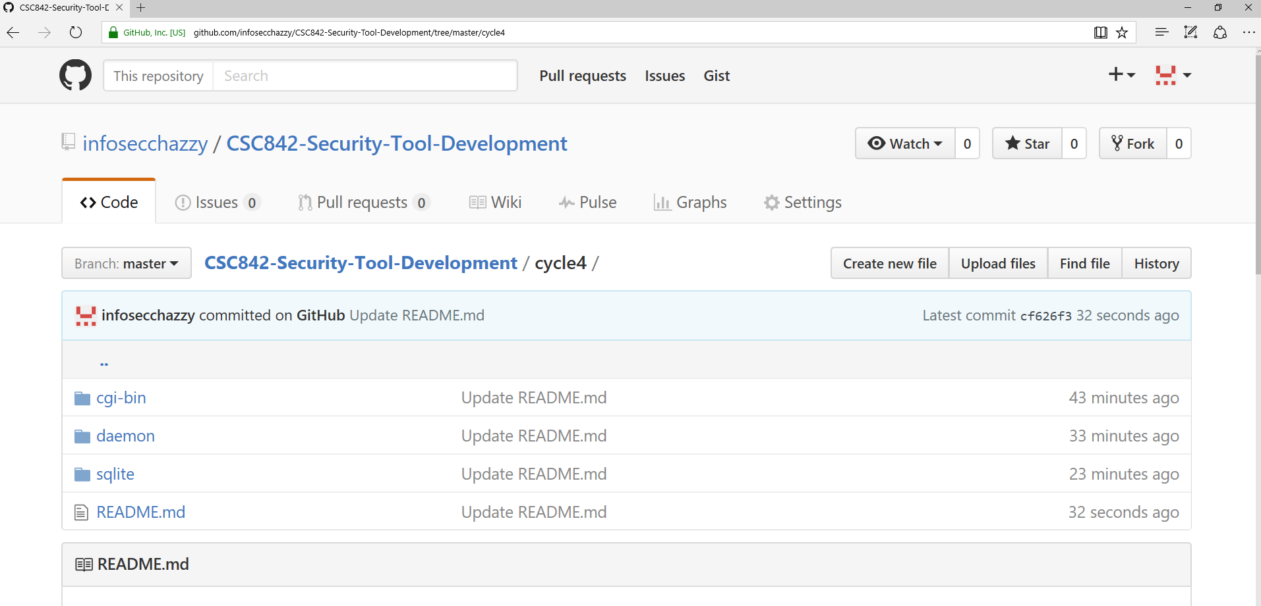
Some Important Info:

Slide 5
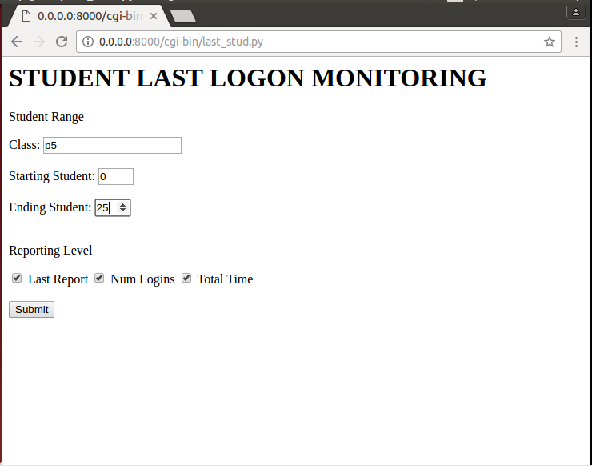
Last Logon Search

Slide 6
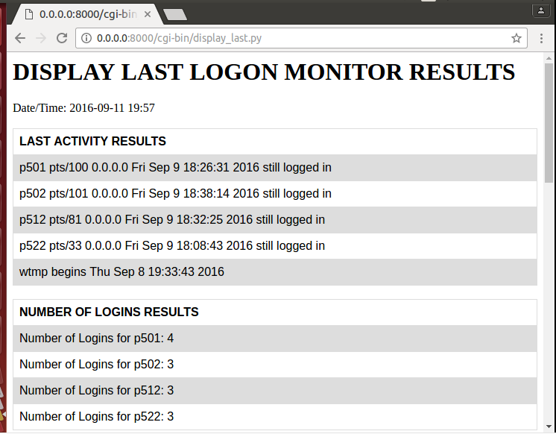
Last Logon Results (1)

Slide 7
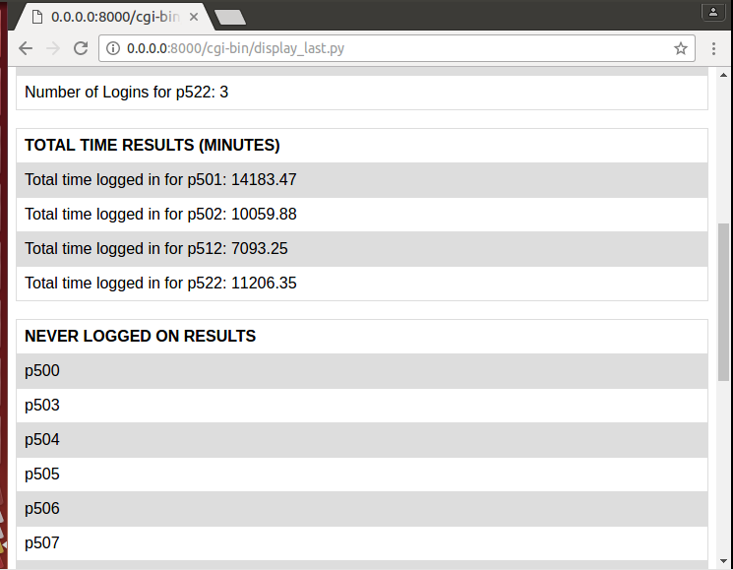
Last Logon Results (2)

Slide 8
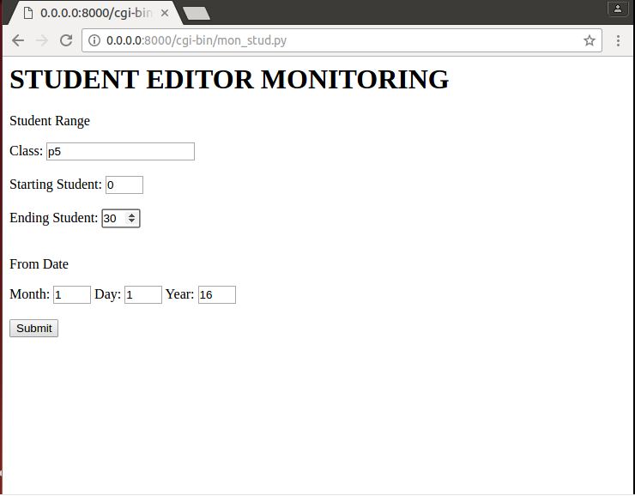
Student Editing Search

Slide 9
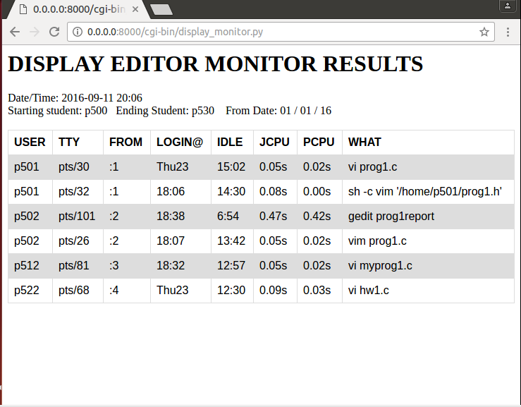
Student Editing Results

Slide 10
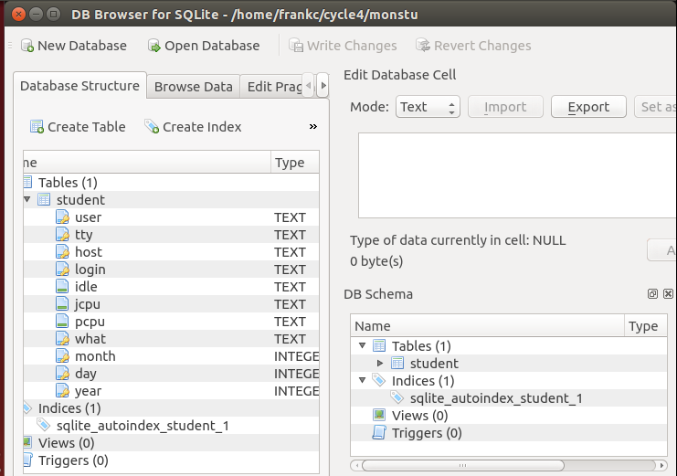
monstu db (1)

Slide 11
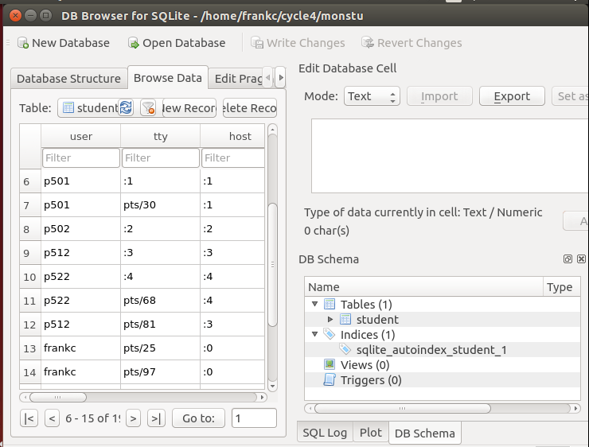
monstu db (2)

Slide 12
monitor_students.py (daemon) (1)
#sqllite db
sqlite_file = '/home/frankc/cycle4/monstu'
conn = sqlite3.connect(sqlite_file)
c = conn.cursor()
sql_command = "PRAGMA journal_mode = WAL"
c.execute(sql_command)
conn.commit()
sql_command = "PRAGMA synchronous = NORMAL"
c.execute(sql_command)
conn.commit()

Slide 13
monitor_students.py (daemon) (2)
#insert the record
sql_command = """INSERT INTO student(user, tty, host, login, idle, jcpu, pcpu, what, month, day, year) VALUES ('%s','%s','%s','%s','%s','%s','%s',"%s",%d,%d,%d)""" % (wf[0],wf[1],wf[2],wf[3],wf[4],wf[5],wf[6],wc,n_month,n_day,n_year)
print sql_command
c.execute(sql_command)
conn.commit()

Slide 14
mon_stud.py
import cgi, cgitb
print """
<html>
<body>
<form action="/cgi-bin/display_monitor.py" method="post">
<h1>STUDENT EDITOR MONITORING</h1>
<p>Student Range</p>
Class: <input type="text" name="f_class" required maxlength = "6"><br><br>
Starting Student: <input type="number" name="f_starting" min=0 max=99 value="0" required><br><br>
Ending Student: <input type="number" name="f_ending" min=0 max=99 value="1" required><br><br>
<p>From Date</p>
Month: <input type="number" name="f_month" min="1" max="12" value="1" required>
Day: <input type="number" name="f_day" min="1" max="32" value="1" required>
Year: <input type="number" name="f_year" min="0" max="99" value="16" required><br><br>
<input type="submit">
</form>
</body>
</html>
"""

Slide 15
display_monitor.py (1)
#Create instance of FieldStorage
form = cgi.FieldStorage()
#Get data from fields
pattern = str(form.getvalue('f_class'))
starting = int(form.getvalue('f_starting'))
ending = int(form.getvalue('f_ending'))
month = int(form.getvalue('f_month'))
day = int(form.getvalue('f_day'))
year = int(form.getvalue('f_year'))
#construct and execute sql select statement
sql_command = "SELECT * FROM student WHERE user BETWEEN '%s' AND '%s' AND month >= %d AND day >= %d and year >= %d" % (from_stud,to_stud,month,day,year)
c.execute(sql_command)

Slide 16
Display_monitor.py (2)
#go thru each row
for row in all_rows :
#if there is an editor in the activity
if editor_found(row[7]) :
print "<tr>"
#go thru and add the field into the table
for i in range(0,8) :
cell = "<td>" + row[i] + "</td>"
print cell
print "</tr>"

